Slide 1
Vandy
Lead Technology Architect
https://vandy.io
https://www.linkedin.com/in/vandy-matthew/

Slide 2
🙋‍♂️
Nickname: Vandy
Last name is Vandergrift, so middle schoolers called me Vandy and it just stuck.

Slide 3
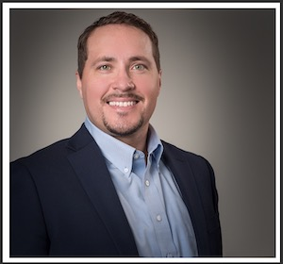
Hi there, and thanks for your time. I’m excited to share some of my story with you today. I think I can help you by sharing what I’ve been doing the past few years. I’ll try to keep it short and if need be we can find some time to talk more.

Slide 4
Quick Look ahead
01
02
03
04
Quote
Quality
Skills
Objectives

Slide 5
—Steve Jobs
1
“Quality is more important then quantity. One home run is better then two doubles”

Slide 6
Quality is more then a buzz word...
2
Quality is like a gem with many shapes and facets not just limited too:
Includes dev requirements, guidelines & practices
SDLC Agile practices
Unit testing & quality checks
Dev Tools & CI / CD / QC tooling
Security Scans (White/Black box)
Peer review process & branching strategy gates.
Repeatable and grows
A mindset about building systems and software that are testable & durable, scalable and maintainable

Slide 7
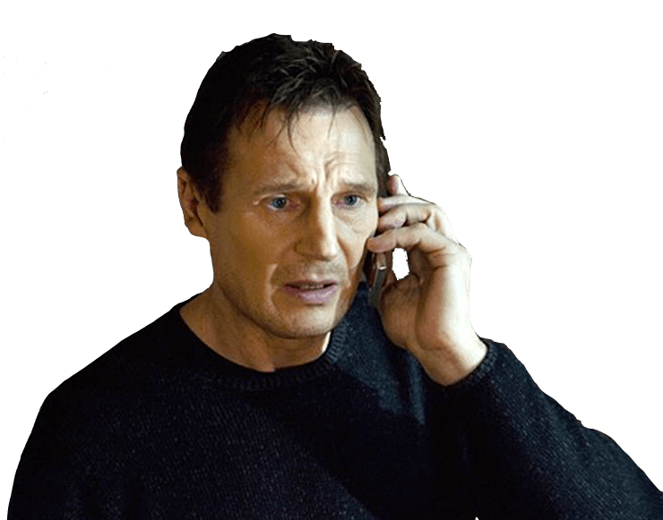
WHAT SETS ME APART?
If you are looking for an on-call person, I can tell you I don't have that. But what I do have are a very particular set of skills; skills I have acquired over a very long career. Skills that make me an asset for people like you. If you let my slides continue it won’t be the end of it. ;) :D
QUALITY DEV
QUALITY PRACTICES
Software dev can be more than just completing units of work, but doing so in a way that allows it to grow homogenously and able to validate itself for completeness over time.
Define a Process. Establishing a process is key to optimizing quality assurance across the development of products.
3

Slide 8
MY OBJECTIVES
4
COLLABORATE
LEARN
Coordinating with others in productive ways while balancing others time and resource constraints
INNOVATE
I take great pride in learning the ins and outs of any technology with the goal to help systems, software’s, users and teams grow effectively
Set the standard - create guidelines, samples & systems that can augment build tools & imbue quality

Slide 9
ABOUT ME
👨‍💻
Learn, grow, share, repeat

Slide 10
MY STRENGTHS
I’m a Passionate Technologist
20+ years experience in developing systems, software, collaborating, creating & supporting people and organizations
Active Mentor and speaker for new collar devs and people branching into technology.
Quality focused engineer using TDD, BDD and best of breed Agile practices.
I believe in hard work, good strategies, feed back loops and adapting to change.

Slide 11

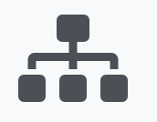


MY EXPERIENCE
Y-Prime
Epic Games
IBM
IBM
Team Lead - Orquestra Architect & Inner Source Maintainer
Integration Guru – Workday Conversion
Full Stack Engineer – IBM Engage Support
Software Architect – Data Concierge

Slide 12
SOME HIGHLIGHTS
AGILE COACH
VOICE AUTOMATION
MOBILE APP
I’m knowledgeable and passionate about the processes of software and systems engineering, not just the code
Created the Worlds first Apple Watch & iPhone Distance alert using cloud based GPS triangulation for improved accuracy over Bluetooth ranging
In 2015 Debuted my voice activated home automation Day 1 at WebSummit in Dublin, Ireland to over 5000 people

Slide 13
MAJOR ACHIEVEMENTS
Pharma’s First Vendor Agnostic Data Integration
Worlds first Apple watch and iPhone Distance Alert using GPS
Voice Activated Home Automation
Fiji – Home Helper - HomeAidePi
Data Concierge - YPrime
BlueBuzz - Homeaidepi
Code Division Multiplexing Algorithm
Data driven API workflow engine
Augmented Reality promotion program
The Pantry – Kangaroo Express
PoC as a self driven learning exercise.
Orquestra - IBM

Slide 14
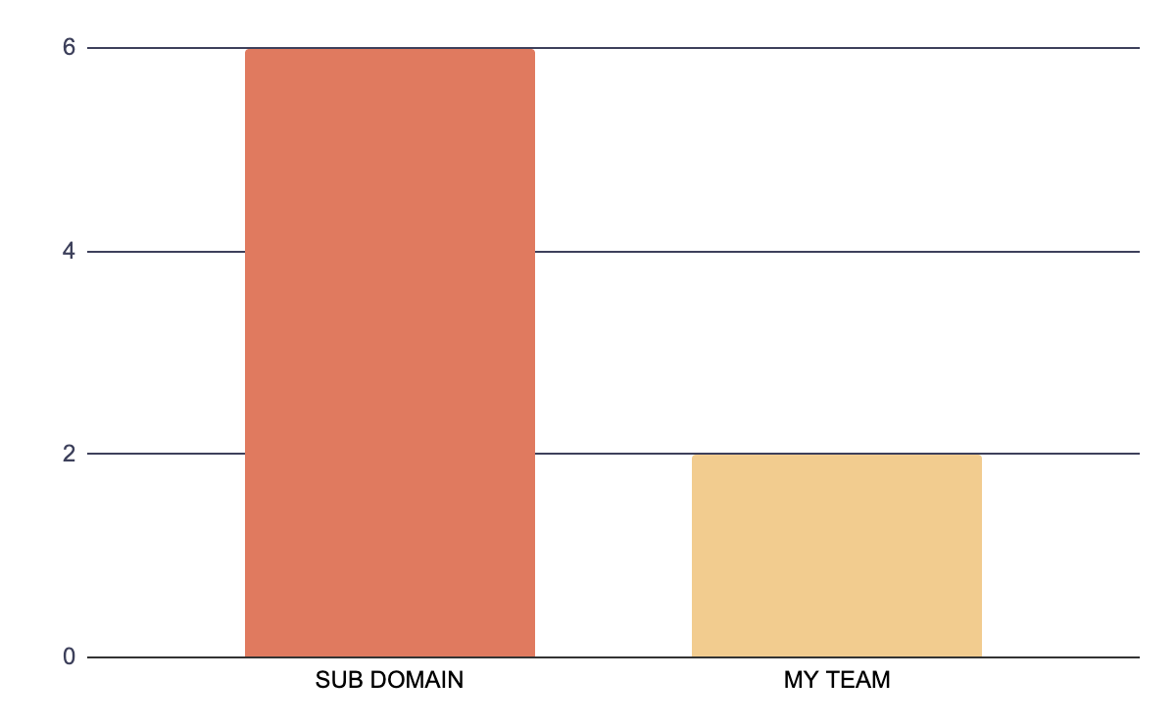
Lowest WIP in our IBM Sub Domain
Sub Domain (250 people)
Second line leaders taxonomy of around 250 people
6 Days
My Team
2 Days
Maintainer, SME and author of standards and practices guidelines that structure the work stream
By structuring our teams SDLC with a focus on quality engineering using TDD and BDD during story creation we align our work stream with better conditions from which to make more accurate estimates based on complexity and create smaller more digestible units of work.

Slide 15
MY VALUES
RESPONSIBILITY
RESPECT
HONESTY
Take ownership and drive decisions even if it could result in failure
Value your time and others time & energy
Being truthful with oneself and others

Slide 16
MY GOALS
Learn
Grow
Share
Dig down and discover problems and pain points
Take your skills in varying directions to grow solutions
Document and champion lessons learned for others

Slide 17
CONCLUSION
I’m Experienced, Passionate and Dedicated
20+ years experience in developing systems, software, collaborating, creating & supporting people and organizations to help them grow platforms and services with a quality focus.
Being a Mentor for new collar devs and people branching into technology has helped me grow my soft skills to be able to communicate effectively across different viewpoints and skills.
Quality focused engineer using TDD, BDD and best of breed Agile practices can inform the process with feedback loops to ensure timely and effective releases that meet the reqs.
I believe in hard work, good strategies, feed back loops and adapting to change. I think I will be an asset to Ferguson and helping to cross over teams using both adept soft and hard skills and managing the difficulties in change while honoring a being fair to recognize anti-change

Slide 18
THANKS FOR YOUR TIME!
Do you have any questions?
Please reach out to Me and we can schedule some more time to talk or deep dive.

